Slide 1

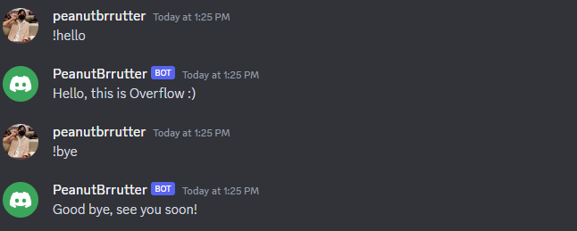
Discord Bots!
Part 2
Coding with Python WOO

Slide 2
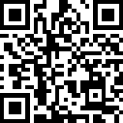
GitHub Repo & Slides (Part One)
Slides: QR code >>
https://tinyurl.com/DiscordBot-PartOne-Slides
GitHub repository:
https://github.com/np-overflow/discord_bot

Slide 3
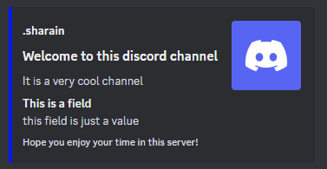
Basic Embedding

Slide 4
Basic Embedding
There are many arguments in an embed (title, author, thumbnail, field, footer, etc.)
set_author, set_thumbnail, add_field, set_footer
Let’s try it out for on_member_join!
`discBot.py`
embed = discord.Embed(title="Welcome to this discord channel", description="It is a very cool channel", colour=discord.Colour.random())
await channel.send(embed=embed)

Slide 5
Basic Embedding
`discBot.py`
@bot.event
async def on_member_join(member):
channel = bot.get_channel(BOT_CHANNEL)
name = member.display_name
pfp = member.display_avatar
embed = discord.Embed(title="Welcome to this discord channel", description="It is a very cool channel", colour=discord.Colour.random())
embed.set_author(name="{}".format(name))
embed.set_thumbnail(url="{}".format(pfp))
embed.add_field(name="This is a field", value="This field is just a value")
embed.set_footer(text="Hope you enjoy your time in this server!")
await channel.send(embed=embed)

Slide 6
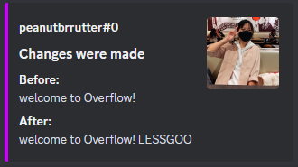
Try it yourself!
Try to format an embed for on_message_edit.
Below is an example of how you can make it look like ☺

Slide 7
Basic Embedding
`discBot.py`
@bot.event
async def on_message_edit(before, after):
if before.author == bot.user:
return;
author = before.author
pfp = author.display_avatar
before_content = before.content
after_content = after.content
channel = before.channel
embed = discord.Embed(title="Changes were made", colour=discord.Colour.random())
embed.set_author(name="{}".format(author))
embed.set_thumbnail(url="{}".format(pfp))
embed.add_field(name="Before:", value="{}".format(before_content), inline=False)
embed.add_field(name="After:", value="{}".format(after_content))
await channel.send(embed=embed)

Slide 8


Bot Moderations

Slide 9
Bot Moderations
Under this section, you will learn how to make your bot:
Check for roles
Moderate server messages
Ban Users
Unban Users

Slide 10

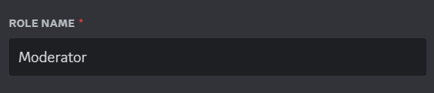
Before starting
Ensure that you have set up a ‘Moderator’ role within your server
To allow the bot to check who are allowed to use certain commands or not
If you do not have one, simply just create on by clicking on the button within the server settings

Slide 11
Bot Moderations
Before starting, you would want to ensure that you have configured the proper roles, the bot and moderator, and their respective permissions.
Starting off:
Quick recap: Ensure that your bot has the proper intents:
`discBot.py`
intents = discord.Intents.default()
intents.message_content = True
intents.members = True

Slide 12


Moderate server messages
Start by defining your array of ‘not allowed’ words
Afterwards, edit the on_message event
`discBot.py`
@bot.event
async def on_message(message):

Slide 13
Moderate server messages
When a user messages, specify the conditions
Loop through the array of ‘not allowed’ words
Check for roles and also content of messages
`discBot.py`
if message.author != bot.user:
for text in blockWords:
if "Moderator" not in str(message.author.roles) and text.lower() in str(message.content.lower()):

Slide 14
Moderate server messages
Once conditions passed:
Delete the problematic message and send out a warning message
Remember to return right after conditions has passed: To stop loop once message has been sent
`discBot.py`
await message.delete()
await message.channel.send("Stop using bad words naughty boy!")
return

Slide 15
Moderate server messages
`discBot.py`
@bot.event
async def on_message(message):
author = message.author
content = message.content
print("{}: {}".format(author,content))
# this is for bot moderations:
await bot.process_commands(message)
if message.author != bot.user:
for text in blockWords:
if "Moderator" not in str(message.author.roles) and text.lower() in str(message.content.lower()):
await message.delete()
await message.channel.send("Stop using bad words naughty boy!")
return

Slide 16

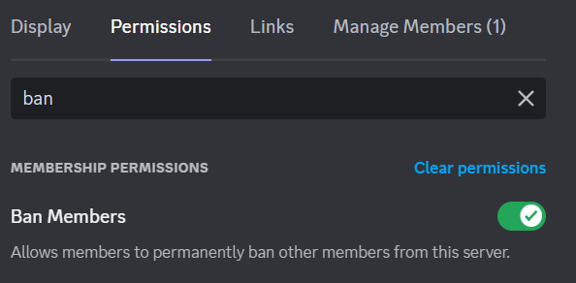

Ban users
Before coding, ensure that your bot has the sufficient permissions
Without it, your bot would not be able to enforce the proper actions

Slide 17
Ban users
@commands.has_any_role("Moderator") – Check for roles
Afterall, you do not want everybody in the server to be able to ban others, right?
`discBot.py`
@commands.has_any_role("Moderator")
async def ban(ctx, user:discord.Member):
if user in ctx.guild.members:
await user.ban()
await ctx.send(f"Banned user: {user.display_name} for reason of treason!")
else:
await ctx.send("User not found")

Slide 18
Ban users
Define the command and ensure that your arguments have a user
Check if user is inside your server
If it is, ban the user and send out a confirmation message, else send an error message
`discBot.py`
@commands.has_any_role("Moderator")
async def ban(ctx, user:discord.Member):
print(str(ctx.author.roles)+"hi")
if user in ctx.guild.members:
await user.ban()
await ctx.send(f"Banned user: {user.display_name} for reason of treason!")
else:
await ctx.send("User not found")

Slide 19

Unban users
Likewise, first check the roles
when defining the command, instead of a user, you pass in a string
This is because when you ban a user, you would not be able to tag them and pass them on as parameters for inputs
`discBot.py`
@bot.command()
@commands.has_any_role("Moderator")
async def unban(ctx, name:str):

Slide 20
Unban users
Access the ban lists via ctx.guild.bans
Check if the passed in name is within the ban list
Unban the user and send out a confirmation message
`discBot.py`
async for entry in ctx.guild.bans(limit=None):
print(entry.user.name)
user = entry.user
entryName = user.display_name
if entryName == name:
await ctx.guild.unban(user)
await ctx.send(f"Unbanned user {user.display_name}")

Slide 21
Unban users
`discBot.py`
@bot.command()
@commands.has_any_role("Moderator")
async def unban(ctx, name:str):
notFound = True
async for entry in ctx.guild.bans(limit = None):
user = entry.user
entryName = user.display_name
if entryName == name:
await ctx.guild.unban(user)
await ctx.send(f"User: {user.display_name} has been unbanned!")
notFound = False
if notFound == True:
await ctx.send("User not found")

Slide 22
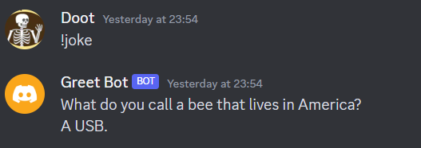
Interacting with APIs

Slide 23
What are APIs?
Application Programming Interfaces, facilitate communication between software applications
Define rules, methods, and conventions for accessing functionalities and data
Widely used in web and mobile development, cloud computing, and other domains.
Developers utilize HTTP requests to access APIs and receive data or perform actions in responses.

Slide 24
Joke Bot
Imports the requests module into the current Python script
Simplifies making HTTP requests and interacting with web APIs
Provides convenient methods like get(), post(), put(), and delete() to send different types of HTTP requests
Widely used for tasks such as fetching data from web APIs, scraping web pages, and interacting with web services
`discBot.py`
import requests

Slide 25
Joke Bot
If no category is provided, it defaults to 'general'.
get_joke() function is called to retrieve a joke based on the category.
If a joke is fetched, it is sent to the Discord channel.
If no joke is retrieved, an error message is sent.
`discBot.py`
@bot.command()
async def joke(ctx, category=None):
if not category:
category = 'general'
joke = get_joke(category)
if joke:
await ctx.send(joke)
else:
await ctx.send('Sorry, I couldn\'t retrieve a joke at the moment.')

Slide 26
Joke Bot
If the category is 'general', sends a HTTP GET request to the joke URL
Checks if response contains both 'setup' and 'punchline' in the JSON data
If so, returns a formatted string combining the setup and punchline
If there is an exception during the request, it ignores continues execution
`discBot.py`
def get_joke(category):
if category == 'general':
joke_url = 'https://official-joke-api.appspot.com/random_joke'
try:
response = requests.get(joke_url)
joke_data = response.json()
if 'setup' in joke_data and 'punchline' in joke_data:
return f"{joke_data['setup']} \n{joke_data['punchline']}"
except requests.exceptions.RequestException:
pass

Slide 27
Joke Bot
If category is 'dadjokes', it sets the joke_url variable to URL to fetch dad jokes
headers = {'Accept': 'application/json'}: Creates a dictionary named headers with a key 'Accept' and value 'application/json'.
'Accept' allows client to indicate preferred format for response
'application/json' indicates that client's preference to receive response in JSON format
`discBot.py`
def get_joke(category):
... elif category == 'dadjokes':
joke_url = 'https://icanhazdadjoke.com/'
headers = {'Accept': 'application/json'}

Slide 28
Joke Bot
Sends an HTTP request and retrieves JSON data
Checks for the existence of a key in the response and returns the corresponding value, which represents the joke
`discBot.py`
def get_joke(category):
... elif category == 'dadjokes': ...
try:
response = requests.get(joke_url, headers=headers)
joke_data = response.json()
if 'joke' in joke_data:
return joke_data['joke']
except requests.exceptions.RequestException:
pass
return None

Slide 29
Class Activity! (15 min)
Goal: Create a bot command called search_track that takes a track name as input and returns information on the track.
Library: The function should be implemented using the Spotipy library.
Installation: Before starting the development process, be sure to pip install the Spotipy library in your command terminal.

Slide 30
Class Activity!
Pre-requisites
…
import spotipy
from spotipy.oauth2 import SpotifyClientCredentials
…
spotify_client_id = “1234"
spotify_client_secret = “1234”
…
spotify = spotipy.Spotify(client_credentials_manager=SpotifyClientCredentials(client_id=spotify_client_id, client_secret=spotify_client_secret))

Slide 31
Class Activity! (15 min)
Basic Functionality
Search for tracks on Spotify based on the given track name.
Retrieve the information for the top 10 tracks matching the search query.
If no tracks are found, send a message to inform the user.
If tracks are found, send a message with the following information about the first track: Track name, Artist name, Album name, Spotify URL for the track

Slide 32
Class Activity! (15 min)
Advanced Functionality
List the top 5 tracks as options, using the format "Track Number. Track Name by Artist Name".
Wait for the user to input a track number selection within 30 seconds.
If the input is invalid, send an error message.
If the input is valid, retrieve the information for the selected track and send a message with the following details: Track name, Artist name, Album name, Spotify URL for the track.

Slide 33
Class Activity!
Basic Functionality:
@bot.command()
async def search_track(ctx, track_name):
results = spotify.search(q=f'track:{track_name}', type='track', limit=10)
tracks = results['tracks']['items']
if not tracks:
await ctx.send('No tracks found.')
return
track = tracks[0]
await ctx.send(f"Track: {track['name']}\nArtist: {track['artists'][0]['name']}\nAlbum: {track['album']['name']}\nSpotify URL: {track['external_urls']['spotify']}")

Slide 34
Class Activity!
Advanced Functionality:
@bot.command()
async def search_track(ctx, track_name):
results = spotify.search(q=f'track:{track_name}', type='track', limit=5)
tracks = results['tracks']['items']
if not tracks:
await ctx.send('No tracks found.')
return
options = []
for i, track in enumerate(tracks, start=1):
option = f"{i}. {track['name']} by {track['artists'][0]['name']}"
options.append(option)
options_message = "\n".join(options)
await ctx.send(f"Choose a track by typing its number:\n{options_message}")

Slide 35
Class Activity!
Advanced Functionality:
@bot.command()
async def search_track(ctx, track_name):
…
def check(msg):
return msg.author == ctx.author and msg.channel == ctx.channel and msg.content.isdigit()
try:
response = await bot.wait_for('message', check=check, timeout=30)
choice = int(response.content)
except discord.ext.commands.TimeoutError:
await ctx.send('Timeout. Please try again.')
return
except ValueError:
await ctx.send('Invalid input. Please enter a valid number.')
return

Slide 36
Class Activity!
Advanced Functionality:
@bot.command()
async def search_track(ctx, track_name):
…
if not 1 <= choice <= len(tracks):
await ctx.send('Invalid selection. Please choose a valid number.')
return
track = tracks[choice - 1]
await ctx.send(f"Track: {track['name']}\nArtist: {track['artists'][0]['name']}\nAlbum: {track['album']['name']}\nSpotify URL: {track['external_urls']['spotify']}")

Slide 37
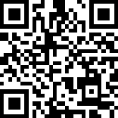
GitHub Repo & Slides (Part Two)
Slides: QR code >>
https://tinyurl.com/DiscordBot-PartTwo-Slides
GitHub repository:
https://github.com/np-overflow/discord_bot

